Slide 1
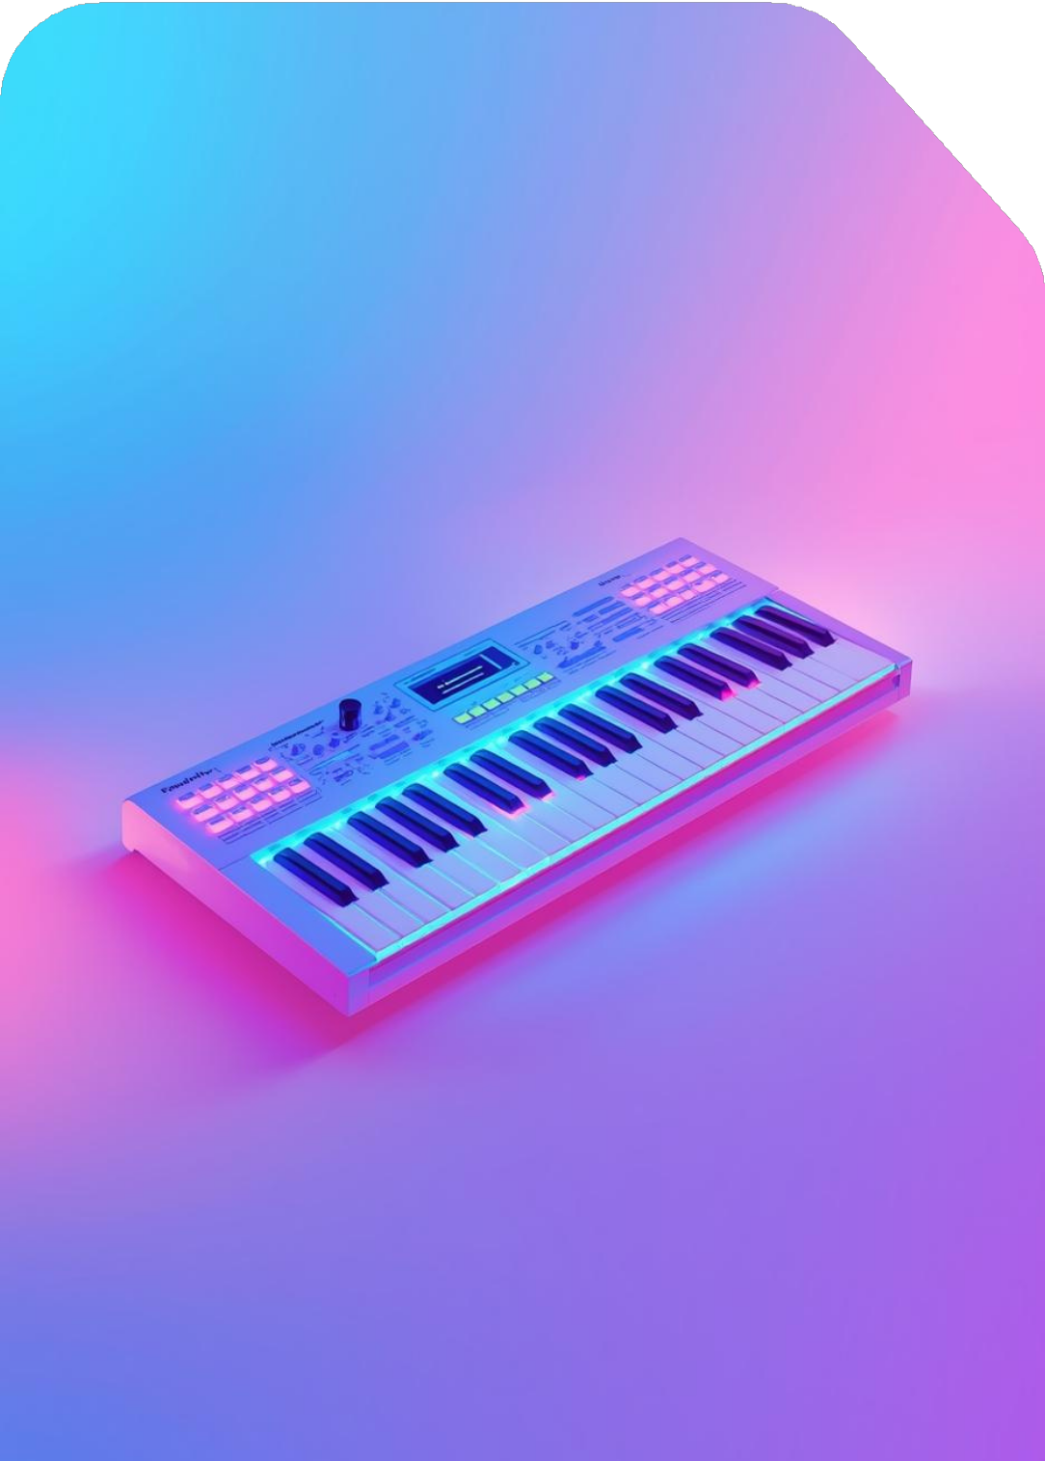
Live Audio to MIDI Conversion
Prisha Kaushal
Ansh Dixit Harshita Aggarwal &
Janvi Sachdeva

Slide 2
Introduction to Basic Pitch
Open-source audio-to-MIDI converter tool
Basic Pitch
Machine Learning
Basic Pitch is an open-source project by Audio Intelligence Lab that effectively transforms live audio performances into editable MIDI files, enhancing flexibility for musicians and composers.
Utilizing advanced machine learning algorithms, Basic Pitch automatically transcribes musical notes from audio, providing a seamless workflow for users to convert and edit their musical creations.

Slide 3
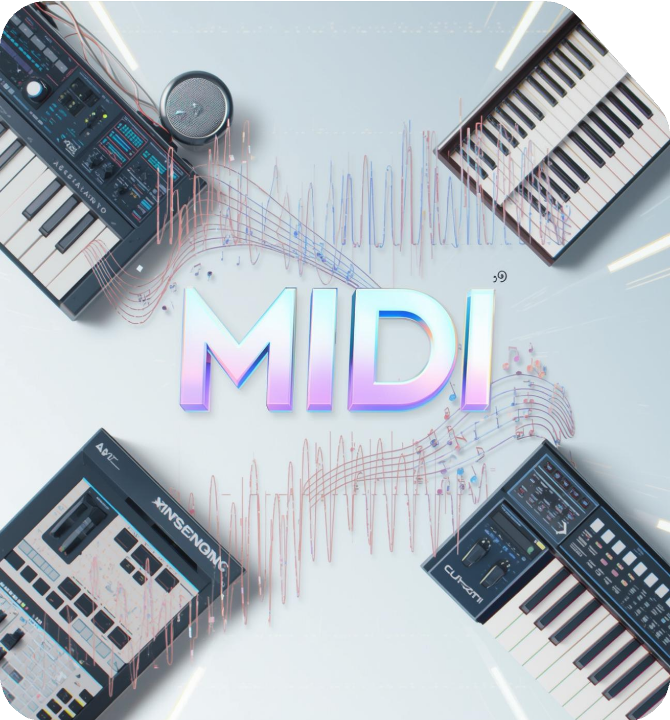
MIDI
MIDI = Musical Instrument Digital Interface Communication protocol between instruments, computers, and software Stores performance data:
Notes Timing Velocity Pitch bends Modulatin Sustain
Does not store actual audio

Slide 4
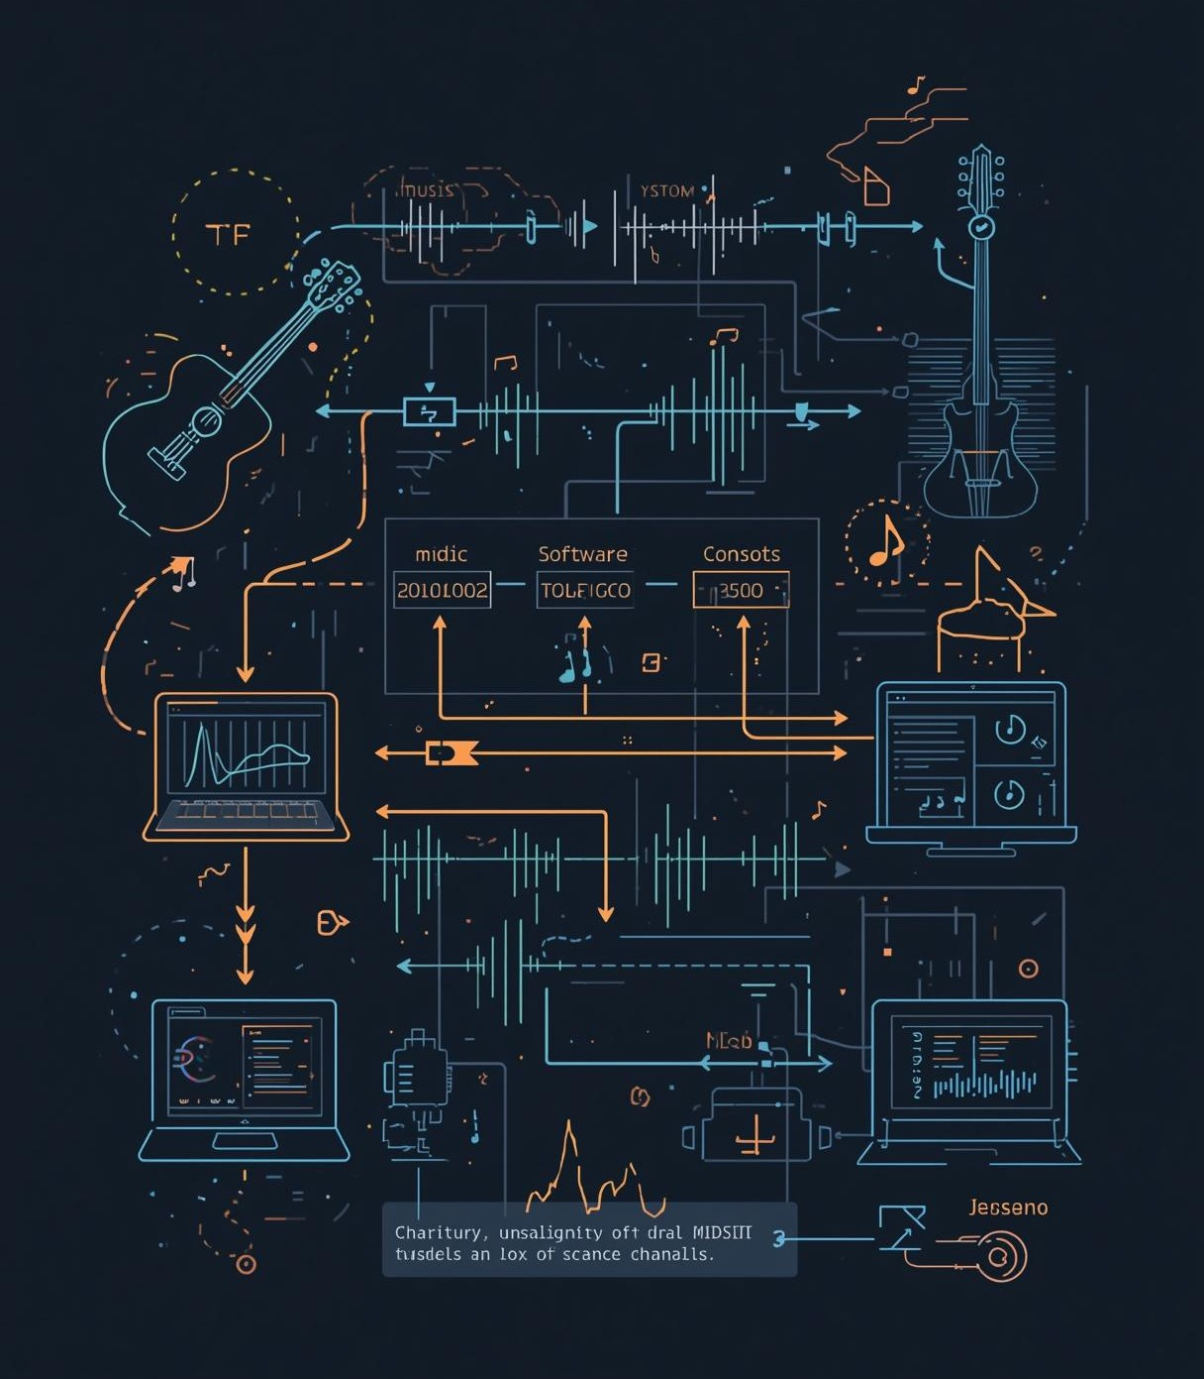
MIDI Signal Flow
Visual representation of audio signal flow process

Slide 5
Features
Polyphonic
Handles overlapping musical notes
Pitch
Estimates glides and bends
Lightweight
Suitable for real-time devices
Expressive
Provides continuous pitch modulation

Slide 6
Model Architecture
Overview of audio processing and structure

Slide 7
GRUs & LSTMs
GRUs
Gated Recurrent Units simplify RNNs, improving performance on sequential tasks effectively.
LSTMs
Long Short-Term Memory networks manage long-range dependencies, crucial for audio processing tasks.

Slide 8
Input Specifications
Mono
Mono audio input is processed at a sample rate of 22050 Hz.
Formats
Supported audio formats include .wav,
.mp3, and .flac for conversion.

Slide 9
Output Specifications
MIDI
Standard MIDI file format containing note information and velocity data for playback.
JSON
Structured format for storing prediction data, facilitating easy integration and analysis.

Slide 10
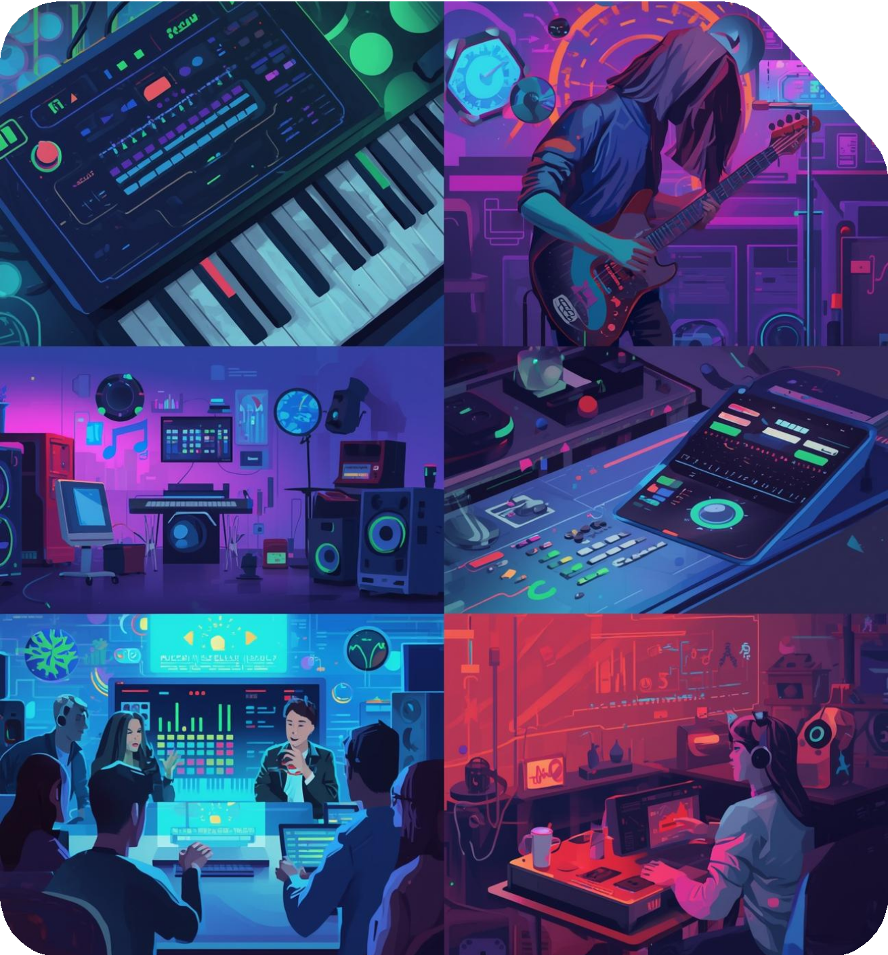

Applications
MIDI authoring: Convert recordings for Digital Audio Workstations (DAWs)
Musicological analysis: Track pitch contours for research
Educational tools: Provide real-time pitch feedback for students
Live performance augmentation: Enhance performances with dynamic MIDI mapping

Slide 11
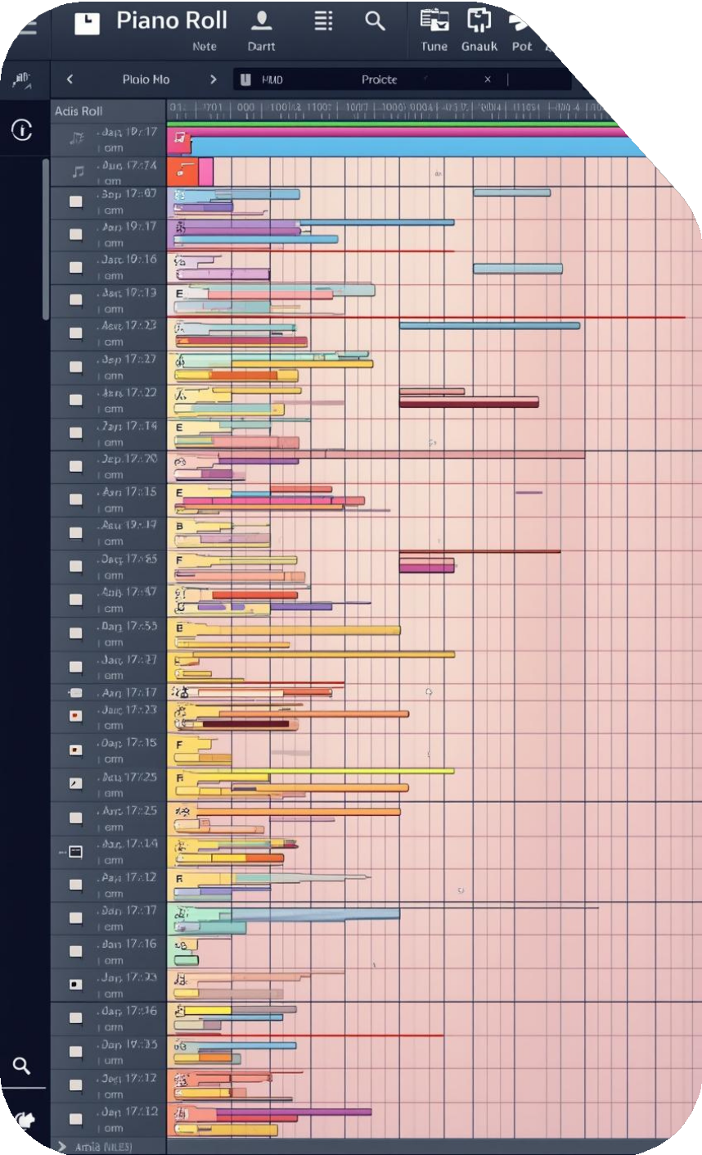
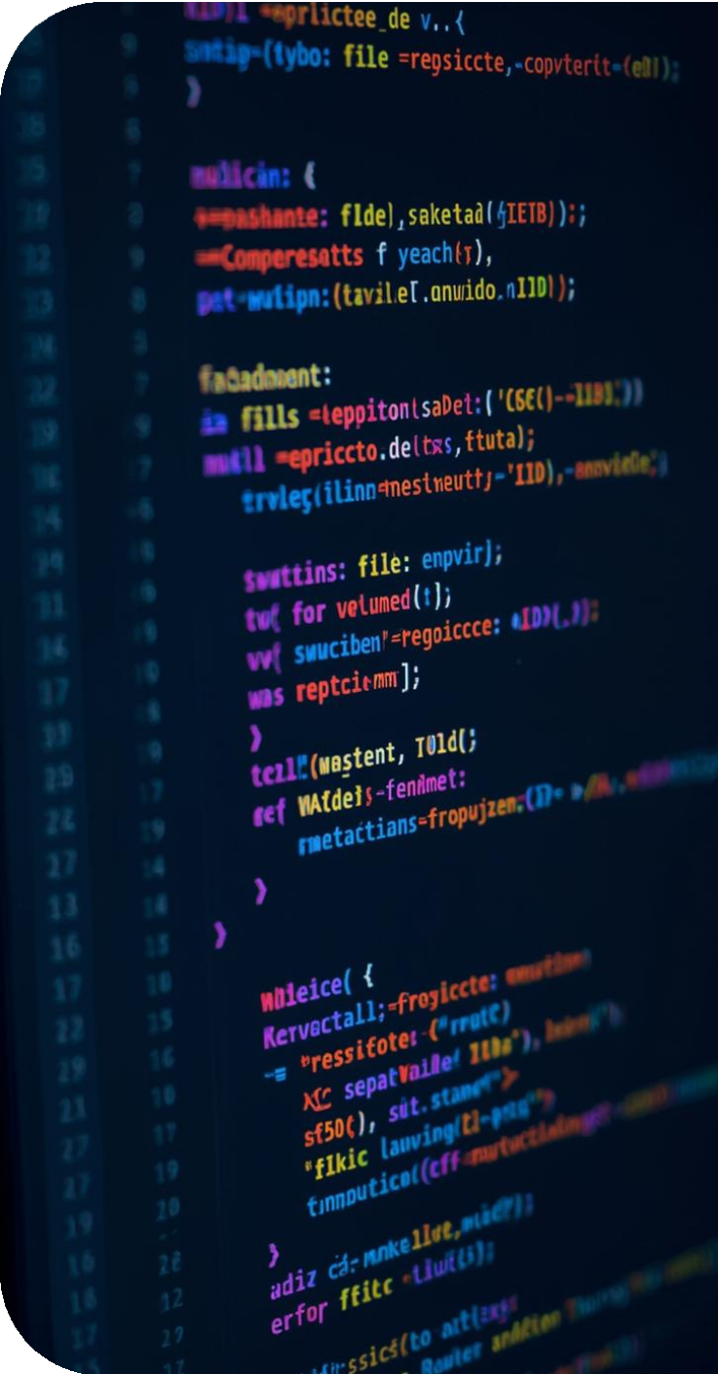
Demonstration and Example
Visualizing MIDI output and code execution

Slide 12
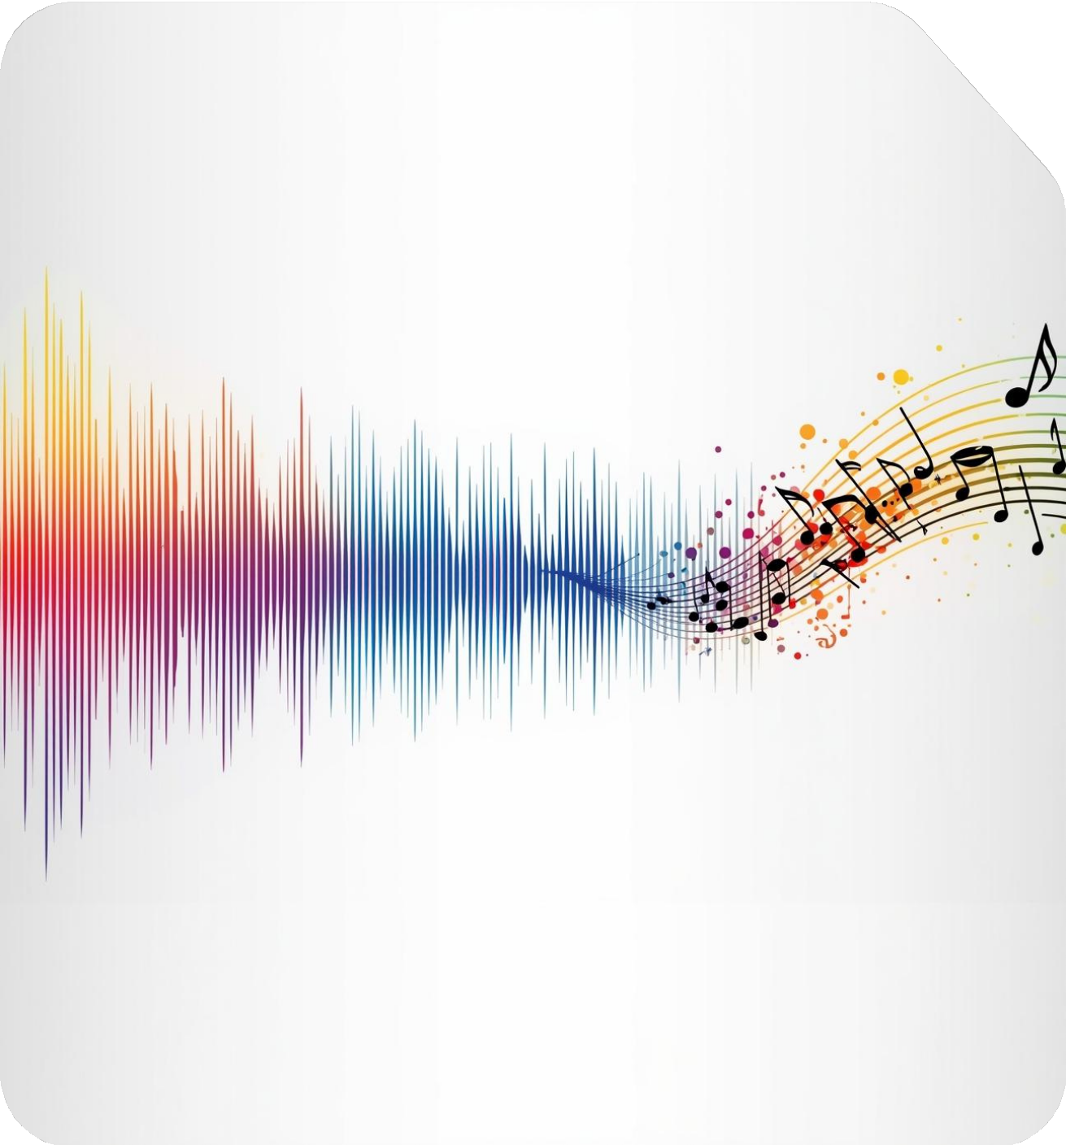
Conclusion
Recap the purpose of converting live audio to editable MIDI files.
Highlight key features like polyphonic transcription and pitch bend estimation.
Discuss real-world applications such as music education and performance enhancement.

Slide 13


